Slide 1
EMG - Driven Wheelchair Project
Erivelton Gualter dos Santos
FEI University Sao Paulo
Notes:
Hello everyone,
Today I will be presenting my work about wheelchair that I have done before arrived in Cleveland during my undergraduate in Brazil.
The main goal of this project was to build a propotype driven wheelchair that can be used for several studies. Since applying control tecniques to control the wheelchair as a purely motorized wheelchair or even as a hybrid wheelchair, where the user still must apply some force in the pushrim to propul the wheelchair.
X- This is an upgraded wheelchair. Initially, it was a manual wheelchair, then we added a couple motors, sensors, and now we can use to study a lot of things that I will explain later.

Slide 2

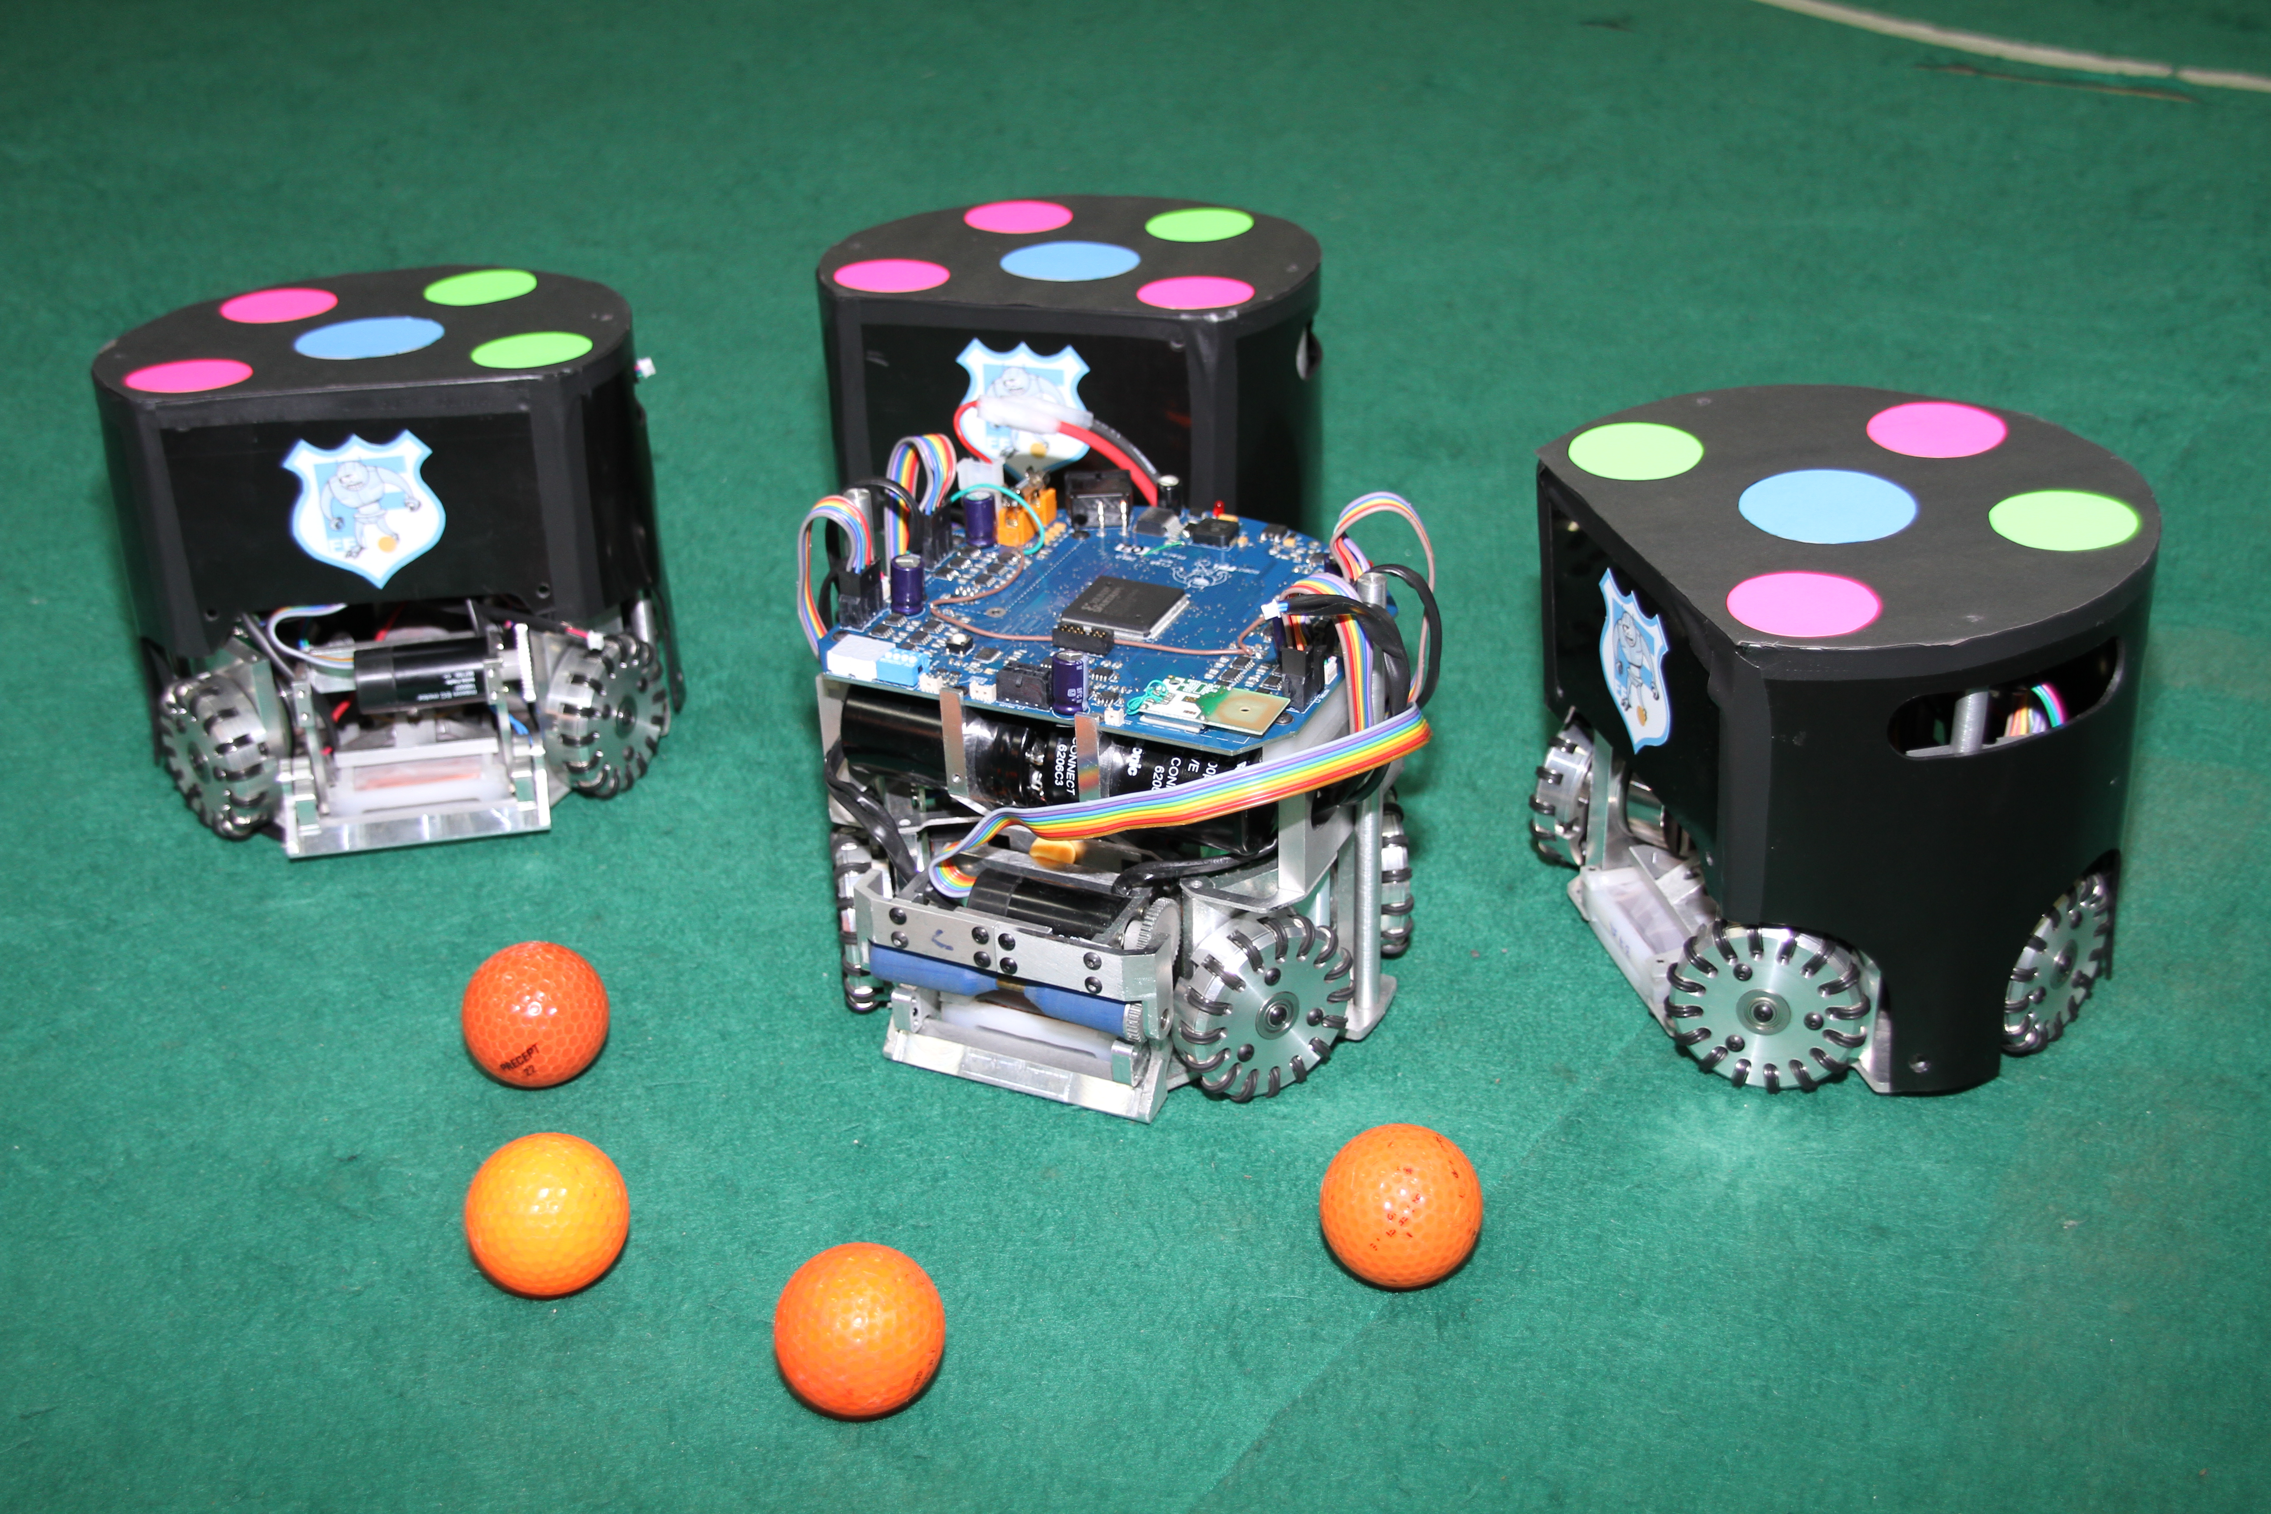
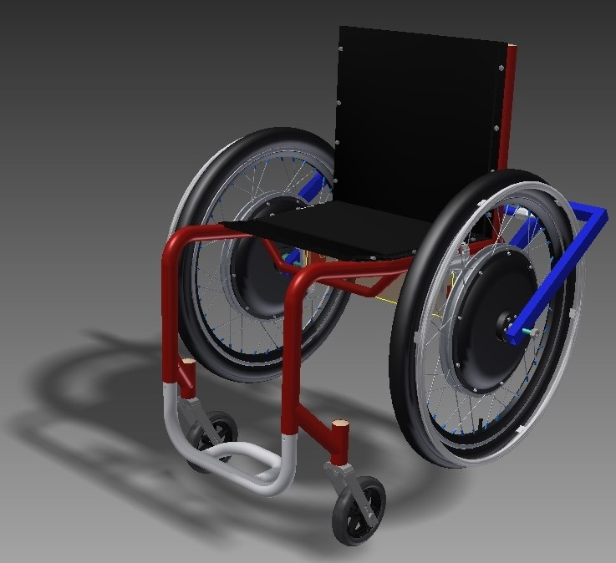
Overview
Automation Control Engineer.
Artificial Intelligence and Robotics laboratory
Assistive Technology Research Center
https://eriveltongualter.github.io
Notes:
But before enter in details I want to take the opportunity and breffly mention some o f the projects I have benn working and also talk about our research group in Brazil called Assistive Techonology Research Center at FEI University.
So, I graduated in Automation and Control Engineer last year in a 5 year graduate program and I really explored all the oporunities related to reasearch and academic life in the colloge.
I tutoried some classes as Physics I and Callulus II.
Also, I worked in the Artificial Inteliggence and Robotocs laboratory developing robots to play soccer in a comppetition called Robocup. I worked there for two years, my main role in the team was sofwatre developing. I develop the strategy of pass system and also designed the kicker.
I will just show a quickly video what is going on.
Then, I joined in the Assistive Tecnology Research Center at FEI to work with wheelchairs.

Slide 3
Robocup
Notes:
But before enter in details I want to breflly talk about what I have worked on and also the goal of our Assistive Techonology Research Center at FEI University.
So, I graduated in Automation and Control Engineer and had the opportunity to work in the Artificial Inteliggence and Robotocs laboratory developing robots to play soccer in a comppetition called Robocup.
Then, I joined in the Assistive Tecnology Research Center at FEI to work with wheelchairs.

Slide 4
Assistive Technology Research Center – NTA (“Nucleo de Tecnologia Assistiva”)
The group is formed by differents departments, such as the electrical, mechanical and biomechnanical department.
Principal Investigator:
  Fleury
Others investigator:
  Leonardi Fabrizio,
  Marko Ackermam,
  Maria Claudia,
  Plinio,
  Sergio.
Create National Assistive Tecnology aimed the power-assisted wheelchair.
Notes:
The Department of Science, Tecnology and Inovation in Brazil have been supporting the universities around the country to create a Assistive Technology Research Center, also know as NTA.
Therefore, all the NTA focus in create tecnology to improve the life os disabilities.
The NTA in FEI University has been studied all kind of wheelchair: manual, motorized and hybrid wheelchair.

Slide 5
Motivation
45.6 million people have some kind of disability
14 million Brazilians have some kind of motor deficiency.
5 million are wheelchair users.
1 to 2% of the planet's population depends on a wheelchair.
Notes:
According to Brazilian Institute of Geography and Statistics there are 45.6 million of people in Brazil that have some kind of disabilty, including motor, hearing, visual and mental disabilities, an others.
14 millioins have some kinf o motor deficiency.
Among them, 5 million are wheelchair user.
It is a lot of people.
Spinal cord injury;
Spina bifida;
Multiple sclerosis;
Amputation of lower limbs;
Polio;
Arthritis;
Stroke;
Advanced age;
Cardiopulmonary disease

Slide 6
Problem
Notes:
The problem we were trying to solve ...
A lot of Negative effect of inmobility.
Spinal cordy injury in younger age, their life expected will reduce. Not because the spinal cordy injuries, my other issues as cardiovascular problems.
Psicologico effect ... ?
Inertial measurment unit and gyroscopic.

Slide 7
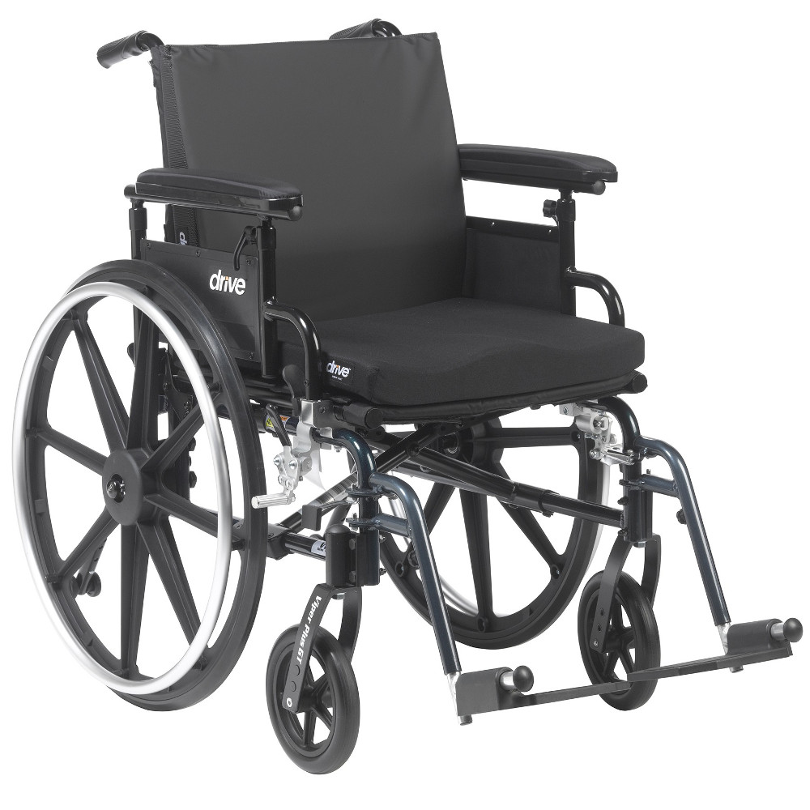
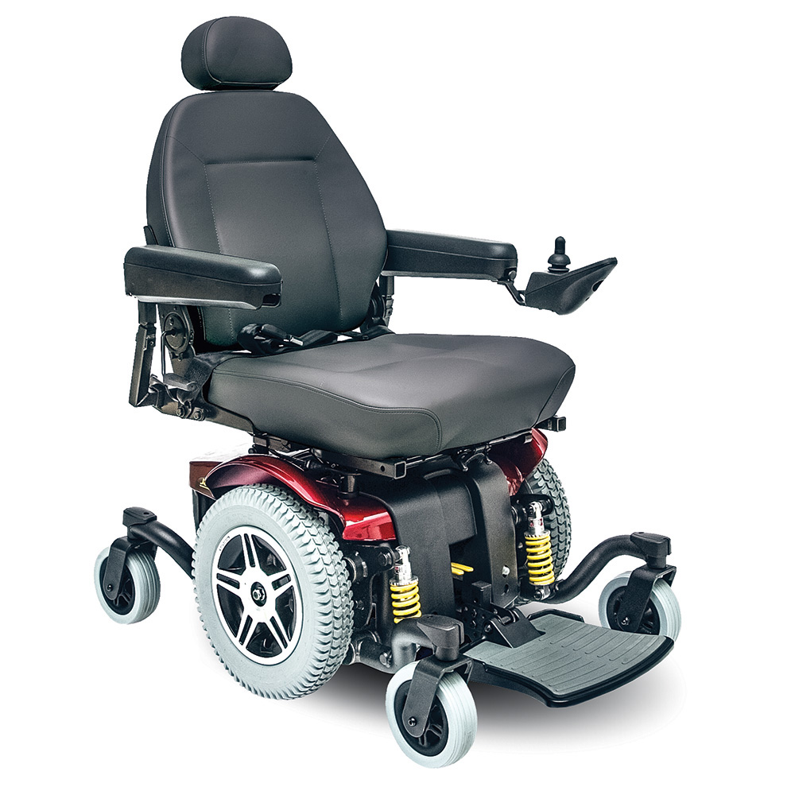
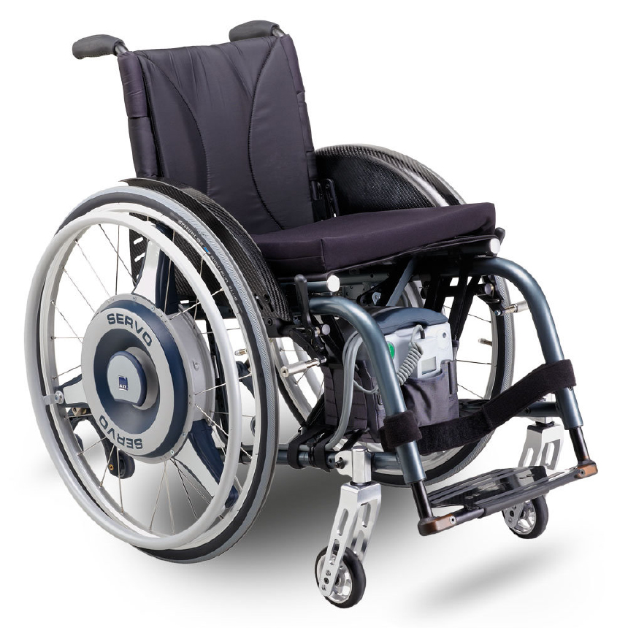
Wheelchair
manual propulsion;
Low cost;
Ligth weight;
portable
Controlled by joystick.
High cost.
Heave weight;
Notes:
Manual wheelchair:
In addition, manual chairs are mechanically simpler, lighter, generally easier to carry, particularly in the case of folding, and provide the user with the possibility of performing physical activity of the upper limbs during propulsion, which has several benefits such as feelings of well-being, reduction of anxiety, improvement of the musculoskeletal and cardiovascular condition, stimulation of the neuroplasticity process, increase of immunity and activation of the metabolism in general.
Motorized Wheelchair:
Power Assisted Wheelchair:

